Slide 1
“They used to go camping”
Разработала
учитель второй категории
Коток Дарья Михайловна

Slide 2
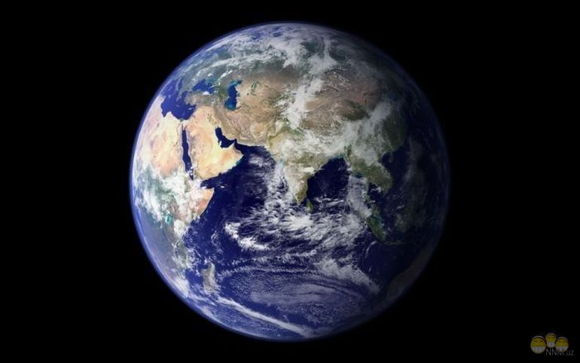
What is the Earth for you?
a part of the universe, my home,
a beautiful planet, a miracle,
a place where I live, the wonderful world.

Slide 3
Nature, environment, ecology, ecological, air, water, forest, river, ocean, animal, to breathe, clean, dirty, plant, to plant, to pollute, polluted, pollution, to protect, protection, to keep, rule,
the atmosphere, toxins, dangerous, in danger, to kill, to burn, to bury, litter, to drop, to save

Slide 4
Ecology
air, water, and land, in which people, animals and plants live
Environment
making water, air, atmosphere dirty and dangerous for people, animals, and plants
Pollution
natural balance between plants, animals and their environment

Slide 5
Are people and nature friends or enemies?
Friends: plant trees; clean rivers and forests;
clean their cities and towns,
have the Red Book of Nature,
save and take care of animals,
sort and recycle rubbish
Enemies: cut down trees; pollute water, air, forests and fields;
kill fish and animals;
drop litter in the streets;
leave litter in the forests

Slide 6
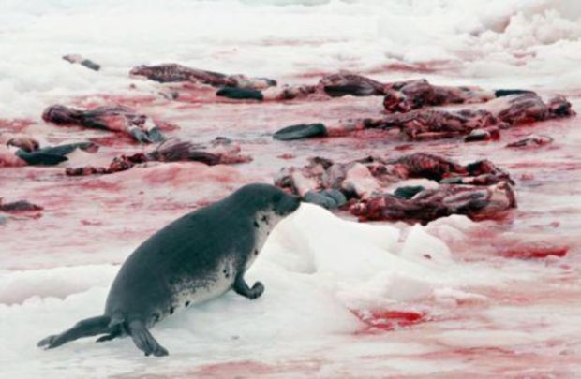
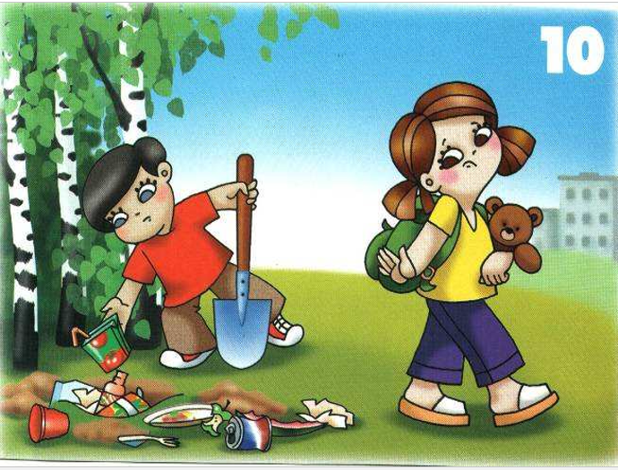
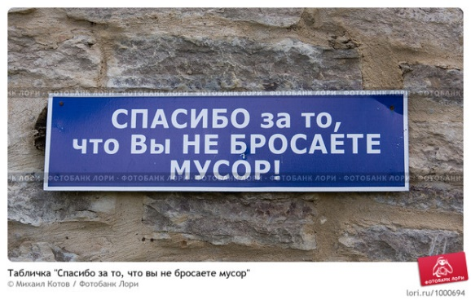
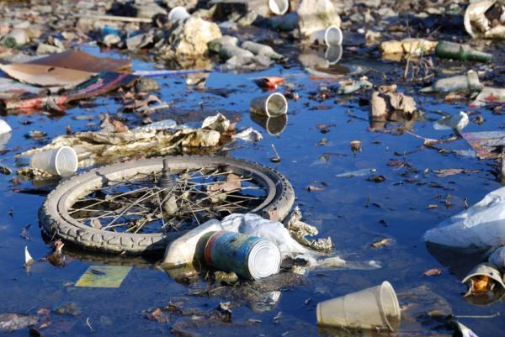

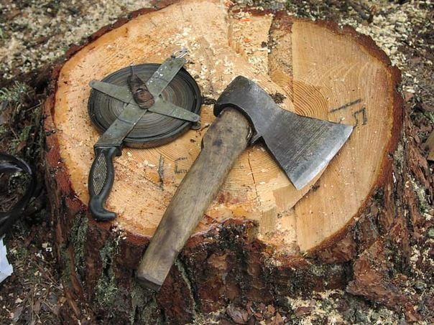
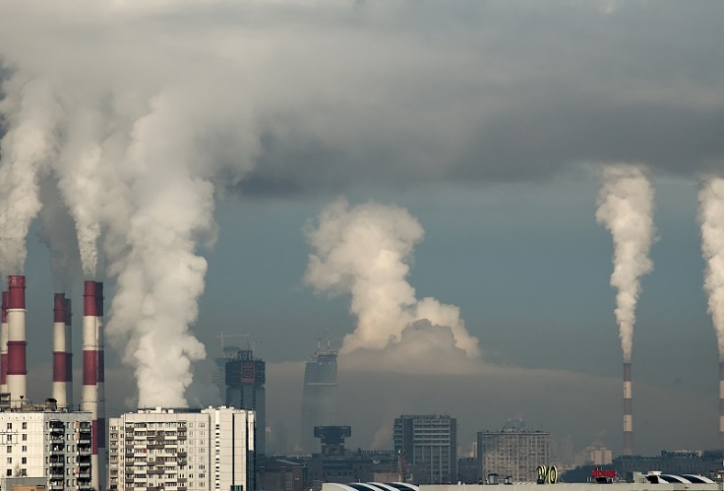
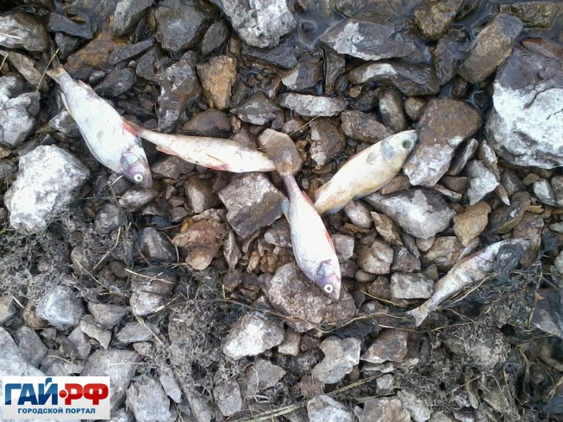
Don’t start a fire.
Don’t drop litter in the streets.
Don’t leave litter in the forests.
Don’t cut down trees.
Don’t pollute water.
Don’t pollute air.
Don’t kill animals.
Don’t kill fish.
Don’t burn litter.

Slide 7
Life on the Earth many years ago
The air used to be fresh
The water used to be clean
The forests used to be big.

Slide 8
Конструкция used to описывает действия, которые регулярно происходили в прошлом,
или, другими словами, имели обыкновение быть. На русский язык эта структура переводится: бывало, имел обыкновение.
Конструкция used to употребляется только в прошедшем времени. Для построения вопросительных и отрицательных предложений ей нужен помощник прошедшего времени did.
They used to go camping two years ago.
Did they use to go camping two years ago?
Where did they use to go camping two years ago?
They didn’t use to go camping two years ago.

Slide 9
- People drop litter in the streets.
- They leave litter and rubbish in the forests.
- They drop litter along the roads (вдоль дорог) and near the chanel.
- We don’t sort and recycle litter

Slide 10
Please put down your home work: Do ex. A,B on page 76 in your textbooks.
The lesson is over.
Good-bye.

